Slide 1

SMS TEXT CLASSIFICATION
CPTS 315 Intro to Data Mining – Ayleah Hill
Notes:
Hi, my name is Ayleah and for my project in CPTS 315, I classified SMS Text messages.

Slide 2

MOTIVATION
An increase in volume of spam calls with development of Covid-19
Between January & October: spam messages increase by 159%
Spam can be dangerous
Notes:
With the development of Covid-19 this year, there has been a significant increase in volume of spam messages and phone calls that people have been receiving. Between January and October 2020 there was an increase in spam calls alone by 159 percent since last year.
Spam messages not only have the ability to waste our time but also have the ability to obtain sensitive information from us that can put us in dangerous situations
As spam messages continue to plague us with no end in sight, I decided I wanted to look into how to identify spam messages in a series of text messages

Slide 3
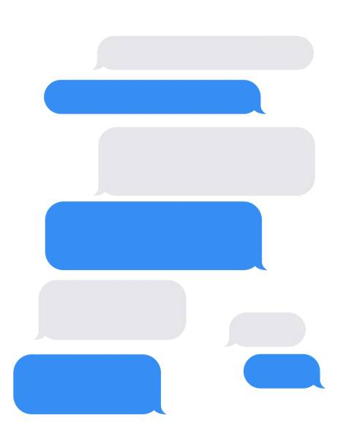
THE PROBLEM
TEXT CLASSIFICATION
Text classification on SMS text messages
Determine whether messages are “spam” or “ham”
Machine Learning method
Notes:
The precise problem I’m trying to solve is how to conduct a text classification on SMS text messages to determine whether the message is a spam message or a standard text message.
The dataset I used had two types of messages: those labelled as “spam” for the spam messages and those labelled as “ham” for the standard text messages
I wanted to look into a machine learning method that would provide a good accuracy rate on the classification.

Slide 4
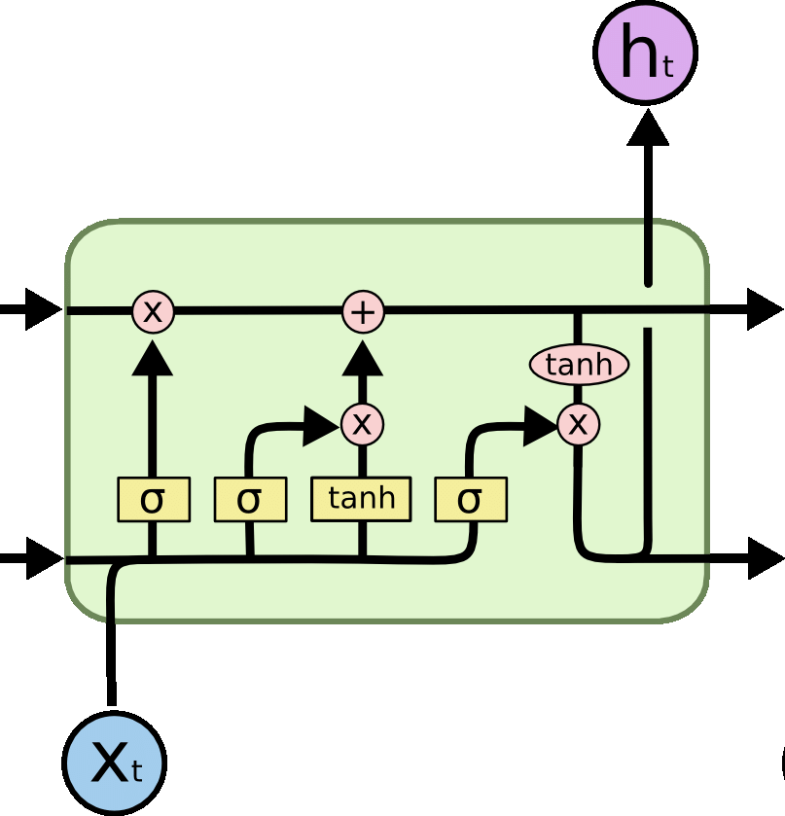
METHODOLOGY
LONG-SHORT TERM MEMORY MODEL
Another approach besides perceptron algorithm
Used in cases for Natural Language Processing
Data passes through gates (learn or forget)
Implemented with the Keras library in Python
Notes:
After having approached a similar text classification problem in class with the perceptron algorithm, I wanted to see what other approaches could be done.
The method I decided to use for the SMS text classification is something called a Long-Short Term Memory model, or LSTM for short.
An LSTM is a form of Recurrent Neural Network that is found in machine learning methods. It has been commonly used in Natural Language Processing (NLP).
LSTMs have a set of gates that the information gets passed through to either learn or “forget” information. An LSTM will run a series of math operations that determines which gate that piece of information goes through.

Slide 5
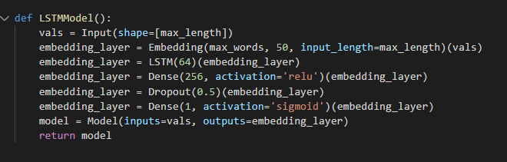
RESULTS
Ran model on training data, then testing data
Accuracy of 0.98
LSTM could be effectively used to flag spam text messages
Notes:
The model first trains on the training data then runs the model on the testing data to see if it can classify the text messages correctly as either “spam” or “ham”.
The results of using the LSTM model showed that there was an accuracy rate of 0.984 when ran through the testing data.
The results show that using an LSTM for text classification is effective and could be used to develop programs that help flag spam text messages and help keep people safe

